Slide 1
Electricity Powertrust Dashboard
GROUP - 5
Apurv Hiteshkumar Sathwara - 0792620
Bhakti Dineshbhai Bhatt - 0788808
Dhrumi Tapas Patel - 0793770
Smit Arora - 0795650
Vismay Lad - 0794141
GitHub link: https://bit.ly/3y3rzPq

Slide 2
Table of Contents
Problem Statement
Research Questions / Objectives
Analytical Goals
Dataset
Preprocessing data
Exploratory Data Analysis
Summary of findings
Next Steps & Future Goals
References

Slide 3

Problem Statement
Over 759 million people continue to lack access to basic electricity and another 2 billion people suffer from inadequate and unreliable access.
Problem Identification –
Effective visualization and communication of data is crucial for decision making and measuring the success of renewable energy projects.
The challenge lies in effectively presenting and interpreting the data in a way that accurately reflects the performance and impact of the renewable energy projects.
Dataset include technical data from electricity meter readings and commercial information from contracts, as well as industry standards for impact metrics. Which is difficult to understand by non-technical team or other members.

Slide 4

Research Questions/Objectives
What are the key performance indicators that should be included in the dashboard?
Adequate use of all the given data
Lucrative Visualizations
How can the dashboard help Powertrust to identify areas for improvement in their renewable energy projects?
Exploratory Data Analysis
In-depth findings
Data-driven Statistics
How can the dashboard be used to communicate the impact of REP to stakeholders, including investors, customers?
Visualized data
Providing Context
Easy to understand

Slide 5
Analytical Goals
Gather relevant data, including commercial contract information, and industry guidelines.
Analyze the data to identify patterns and insights.
Design the dashboards to effectively present the data in a clear and meaningful way.
Implement the dashboards using software tools for data visualization.
Continuously improve the dashboards based on feedback and changes in the data.
Conducting research on various technical tools (such as PowerBI or Tableau) that can be used to develop the dashboards, creating initial drafts of the dashboards using the available data.

Slide 6
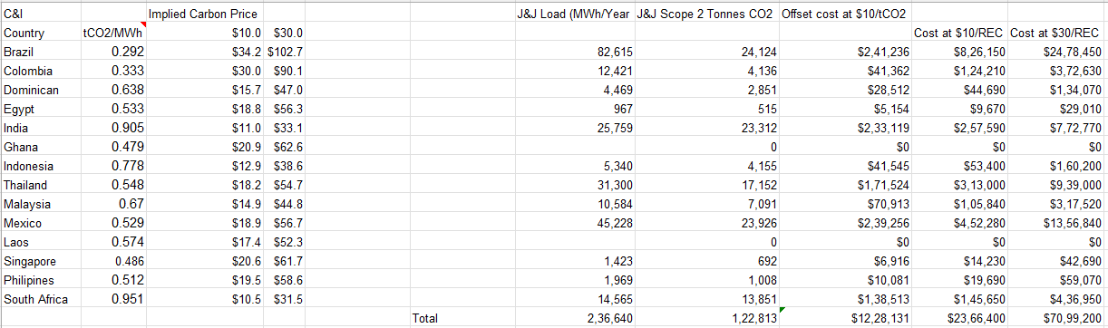
Data
The data has been provided by the Powertrust’s stakeholder which contains total of 12 excel csv files.
It includes information about how much electricity produced by REC and how much offset cost at a $10 and $30/REC across the globe.
The other files have data about renewable energy production in a year 2022 with Timestamp.
The datasets feature a mix of numeric and categorical variables (with numerical variables being in overwhelming majority).
It also include few of REC terms such as MWh, KWh, Capex, tCO2/MWh, J&J Load etc.

Slide 7
Data Pre-Processing
There were few blank cells available in the provided data which we have removed with the help of Excel and made the data convenient for visualizations.
Also, we’ll do merging of data files of cities for the other dashboard because they all have similar kind of data but different cities.

Slide 8

Exploratory Data Analysis

Slide 9
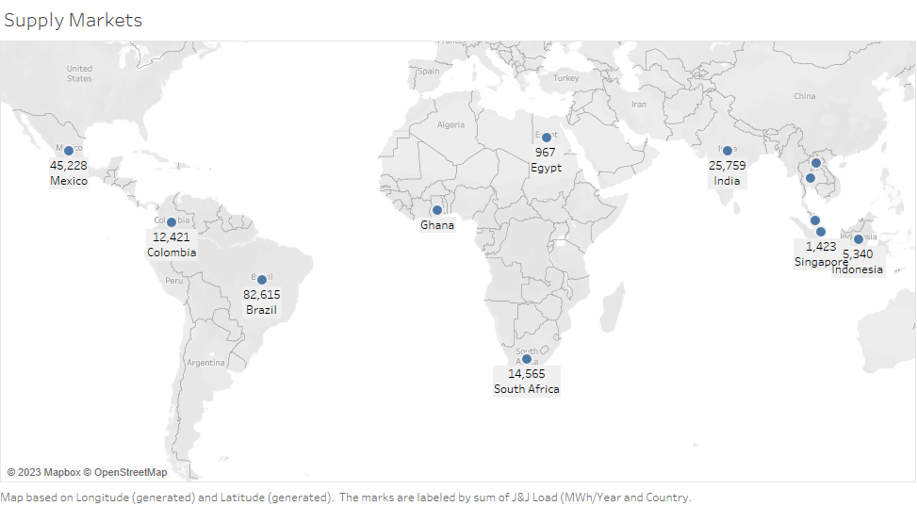
This symbol map shows the J & J Load (MWh/Year) Production in different countries across the globe.

Slide 10
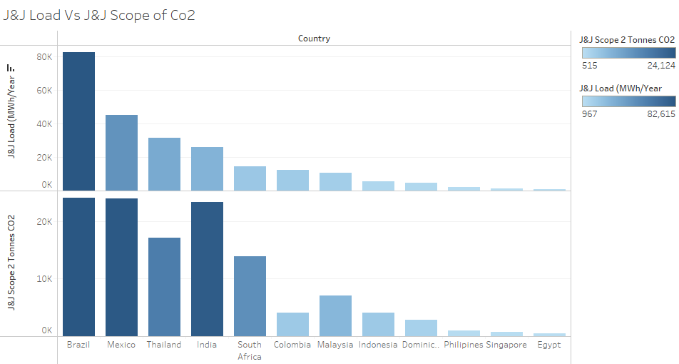
This Histogram shows the country wise production of J & J load which is MWh/Year and J & J Scope of Co2 which is combination of J & J load and tCo2 generation per MWh

Slide 11
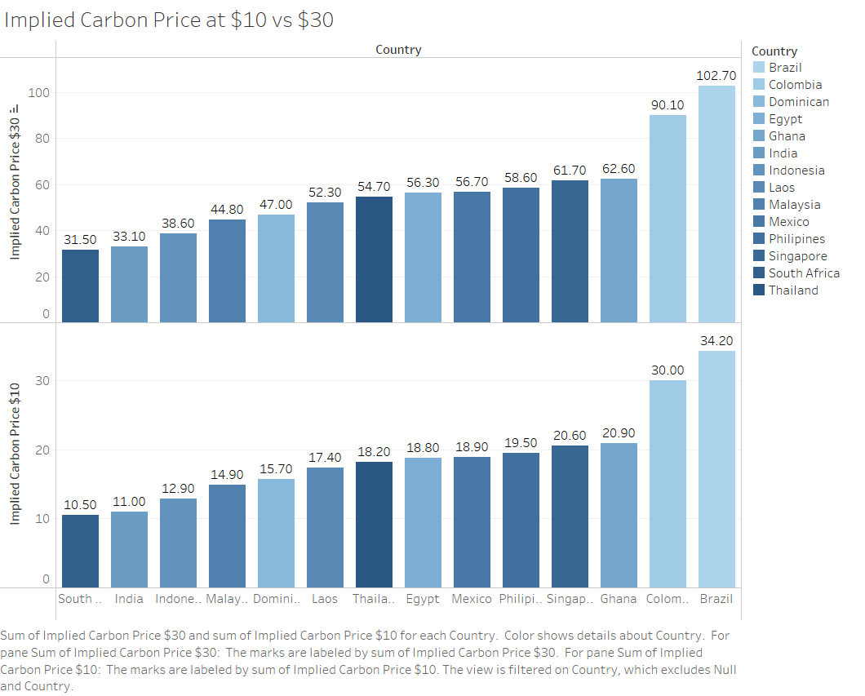
This shows the Implied price of Carbon as per the tCo2 eruption with respect to $10 and $30.

Slide 12
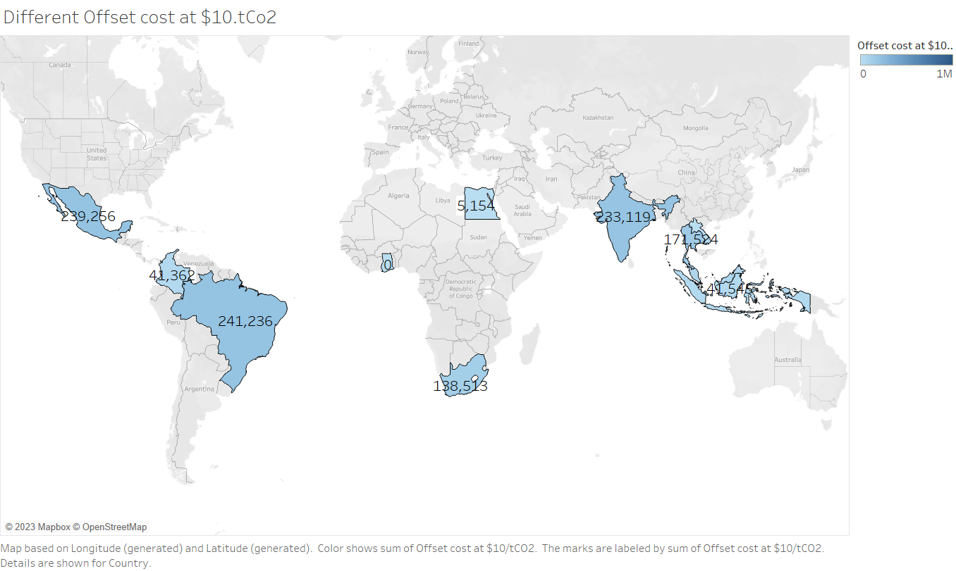
It depicts the offset cost of the $10 which combines with the J & J scope which is basically J & J Load with tCo2.

Slide 13
Summary of current findings
The purpose of the dashboard is to support decision-making, promote transparency, and improve the understanding of the electricity sector.
• Data visualization: The dashboard will provide visual representations of data, such as charts, graphs, and maps, to help users understand and interpret data more easily.
• Data analysis: To support the discovery of insights and trends in the data.
• Customization: Allow users to customize their view of the data, such as by selecting specific data sets or metrics to display, to meet their specific needs and requirements.
• User experience: The dashboard may have a user-friendly and intuitive interface to make it easy for users to access and use the data and insights provided.

Slide 14
Next Steps
We don’t have much information regarding any previous solution which company is using right now. We have a general understanding of who they are, their activities, and their long-term goals.
So, In upcoming steps we are looking forward to do better Data Visualization with the different technologies.
Also, We aim to make it more feasible, understandable and more attractive for the stakeholders.
Asked for more detailed data as this data is short for in-depth findings and more enlightenment.

Slide 15

References
. https://www.powertrust.com
https://towardsdatascience.com/exploratory-data-analysis-8fc1cb20fd15
https://www.eea.europa.eu/themes/energy/renewable-energy/renewable-energy-in-europe-2022
https://www.cer-rec.gc.ca/en/data-analysis/energy-commodities/electricity/report/canadas-renewable-power/index.html

Slide 16
Thank You

